Slide 1
STATISTICAL THERMODYNAMICS
M.Sc. Chemistry

Slide 2
Statistical thermodynamics
Statistical thermodynamics, or statistical mechanics, is the study of the microscopic behaviors of thermodynamic systems using statistical methods and probability theory.
The essential problem in statistical thermodynamics is to determine the distribution of a given amount of energy E over N particles in a system. The macroscopic properties, such as thermodynamic energy, heat capacity, etc., can be calculated in terms of partition functions.
Statistical thermodynamics is a bridge of connecting between macroscopic and microscopic properties of a system.

Slide 3
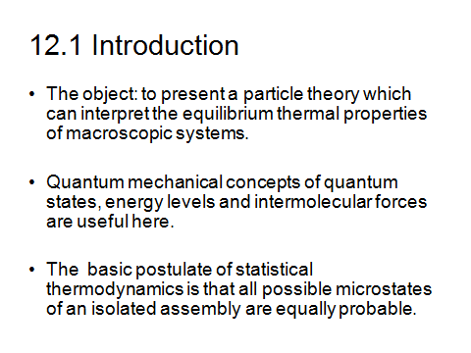
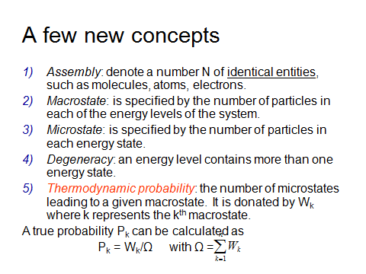

Slide 4
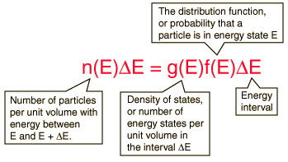
The Distribution of Energy
The distribution of a fixed amount of energy among a number of identical particles depends upon the density of available energy states and the probability that a given state will be occupied. The probability that a given energy state will be occupied is given by the distribution function, but if there are more available energy states in a given energy interval, then that will give a greater weight to the probability for that energy interval.

Slide 5
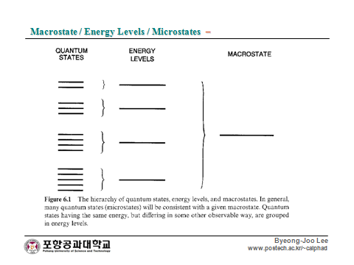

Slide 6
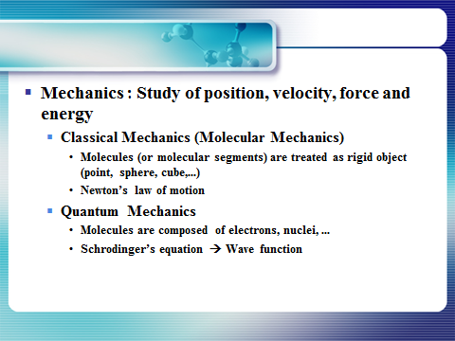

Slide 7
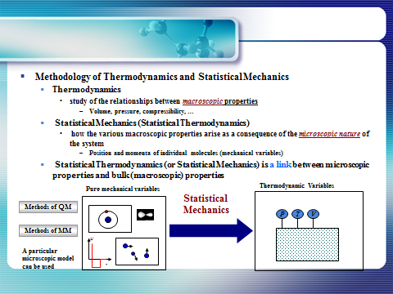

Slide 8
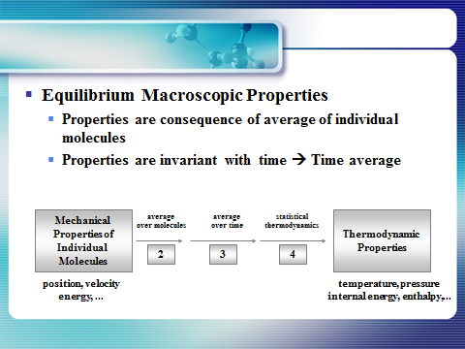

Slide 9
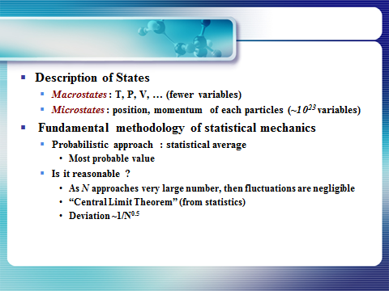

Slide 10
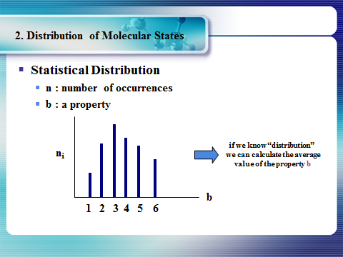

Slide 11
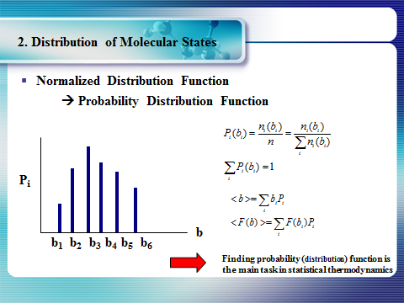

Slide 12
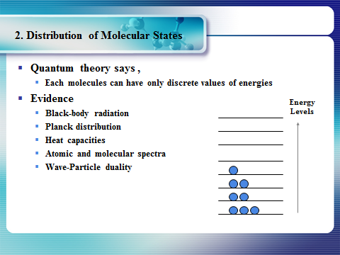

Slide 13
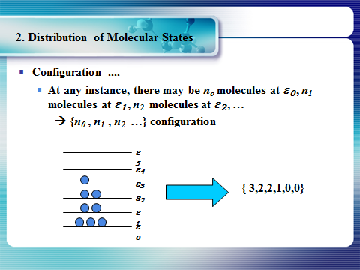

Slide 14
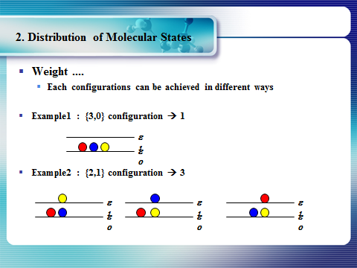

Slide 15
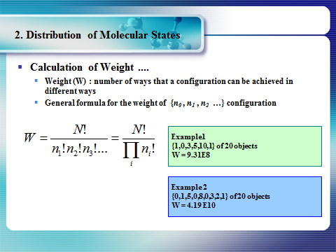

Slide 16
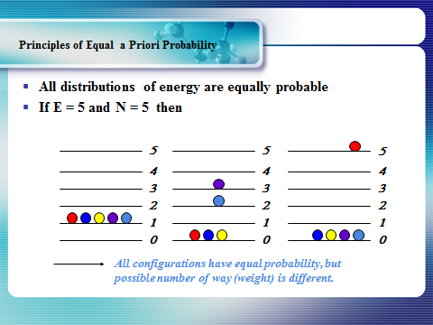

Slide 17
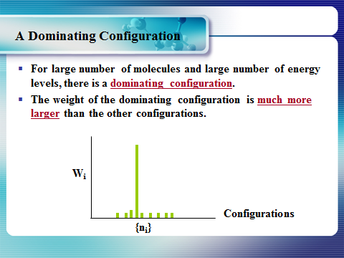

Slide 18
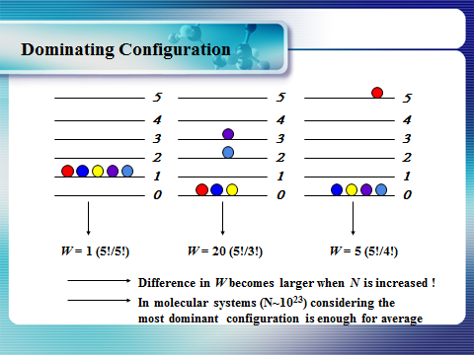

Slide 19
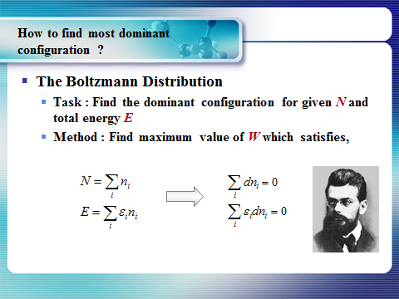

Slide 20
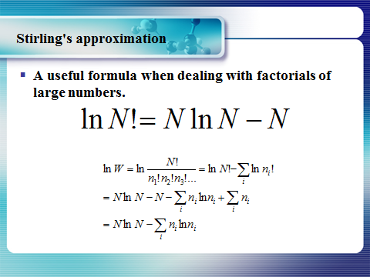

Slide 21
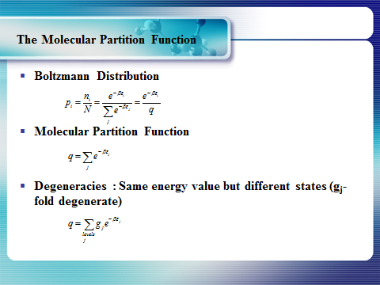

Slide 22



The Energy Distribution Function
The distribution function f(E) is the probability that a particle is in energy state E. The distribution function is a generalization of the ideas of discrete probability to the case where energy can be treated as a continuous variable. Three distinctly different distribution functions are found in nature. The term A in the denominator of each distribution is a normalization term which may change with temperature.
Identical but distinguishable particles.
Examples:
Molecular speed distribution
Identical indistinguishableparticles with integer spin (bosons).
Examples:
Thermal radiation
Specific heat
Identical indistinguishable particles with half-integer spin (fermions).
Examples:
Electrons in a metal
Conduction in semiconductor.

Slide 23


The Density of States
The distribution of energy between identical particles depends in part upon how many available states there are in a given energy interval. This density of states as a function of energy gives the number of states per unit volume in an energy interval. The term "statistical weight" is sometimes used synonymously, particularly in situations where the available states are discrete. The physical constraints on the particles determine the form of the density of states function.
For electrons in a metal the density of states comes from the wave nature of the electron in the "particle in a box" type setting.
For photons where the relationship between energy and wavelength is
the density of states is

Slide 24
Spin Classification One essential parameter for classification of particles is their "spin" or intrinsic angular momentum. Half-integer spin fermions are constrained by the Pauli exclusion principle whereas integer spin bosons are not. The electron is a fermion with electron spin 1/2. The spin classification of particles determines the nature of the energy distributionin a collection of the particles. Particles of integer spin obey Bose-Einstein statistics, whereas those of half-integer spin behave according to Fermi-Dirac statistics.
Fermions Fermions are particles which have half-integer spin and therefore are constrained by the Pauli exclusion principle. Particles with integer spin are called bosons. Fermions include electrons, protons, neutrons. The wave function which describes a collection of fermions must be antisymmetric with respect to the exchange of identical particles, while the wave function for a collection of bosons is symmetric. The fact that electrons are fermions is foundational to the buildup of the periodic table of the elements since there can be only one electron for each state in an atom (only one electron for each possible set of quantum numbers). The fermion nature of electrons also governs the behavior of electrons in a metal where at low temperatures all the low energy states are filled up to a level called the Fermi energy. This filling of states is described by Fermi-Dirac statistics.
Bosons Bosons are particles which have integer spin and which therefore are not constrained by the Pauli exclusion principle like the half-integer spin fermions. The energy distribution of bosons is described by Bose-Einstein statistics. The wavefunction which describes a collection of bosons must be symmetric with respect to the exchange of identical particles, while the wavefunction for a collection of fermions is antisymmetric. At low temperatures, bosons can behave very differently than fermions because an unlimited number of them can collect into the same energy state. The collection into a single state is called condensation, or Bose-Einstein condensation. It is responsible for the phenomenon of superfluidity in liquid helium. Coupled particles can also act effectively as bosons. In the BCS Theory of superconductivity, coupled pairs of electrons act like bosons and condense into a state which demonstrates zero electrical resistance. Bosons include photons and the characterization of photons as particles with frequency-dependent energy given by the Planck relationship allowed Planck to apply Bose-Einstein statistics to explain the thermal radiation from a hot cavity.

Slide 25
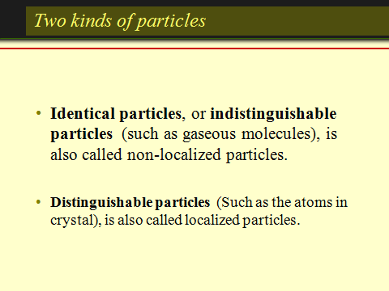
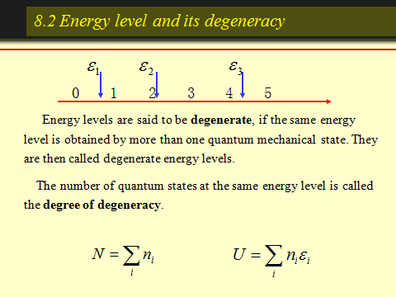
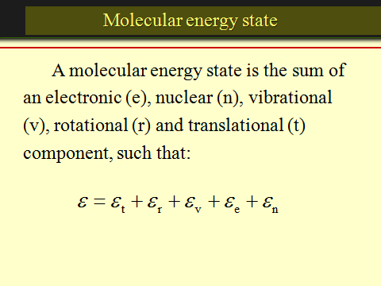
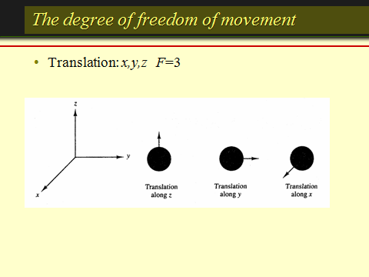
Statistical thermodynamics

Slide 26
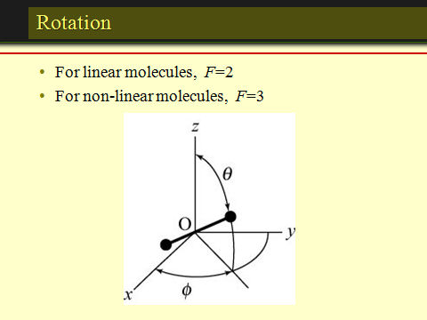
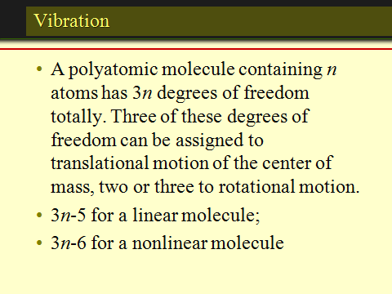
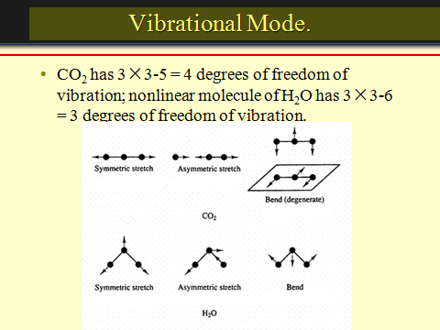
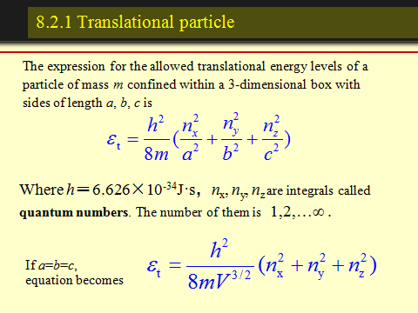
Statistical thermodynamics

Slide 27
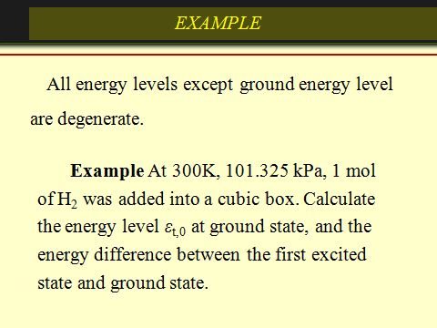
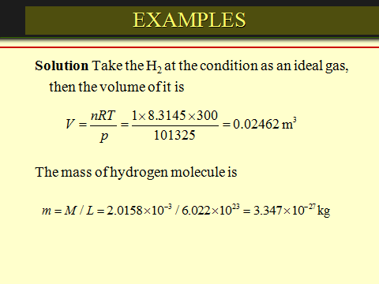
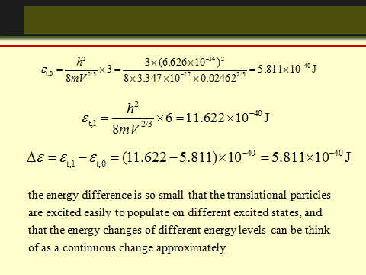
Statistical thermodynamics

Slide 28
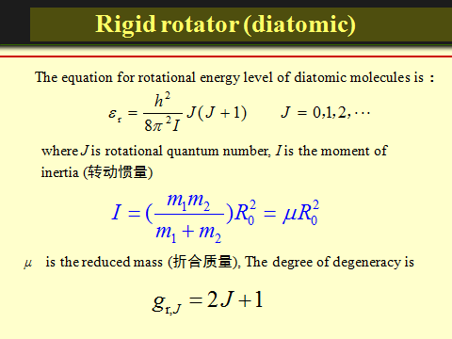
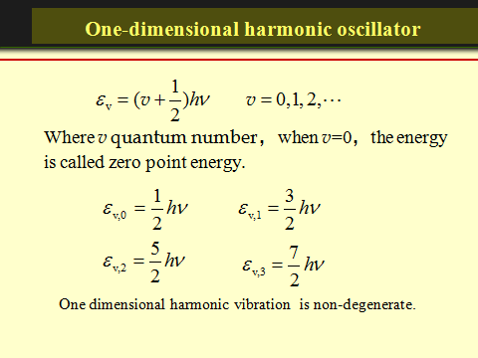
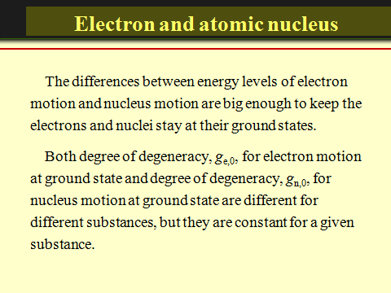
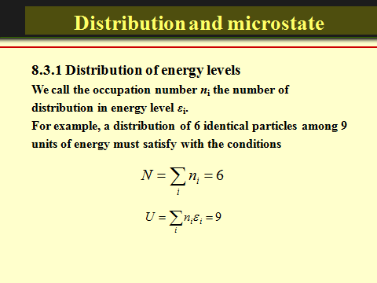
Statistical thermodynamics

Slide 29
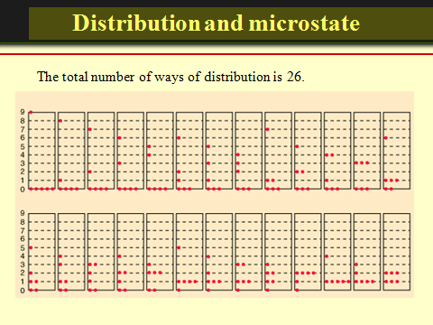
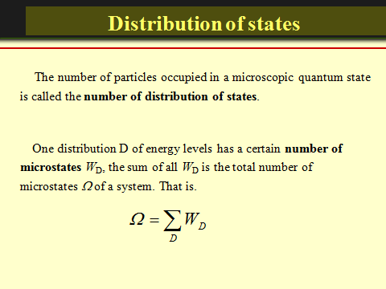
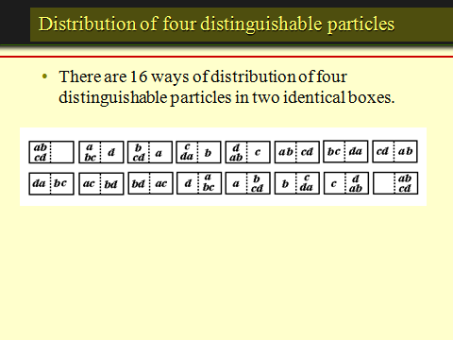
Statistical thermodynamics

Slide 30
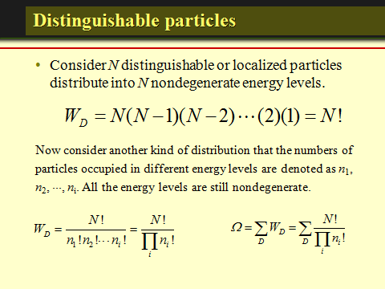
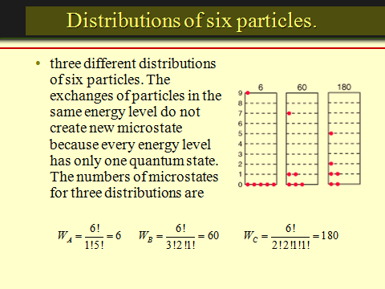
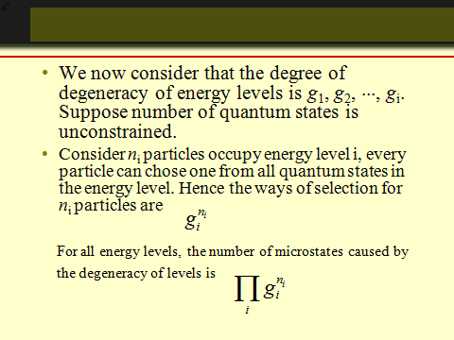
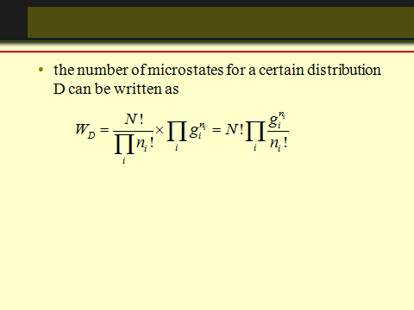
Statistical thermodynamics

Slide 31
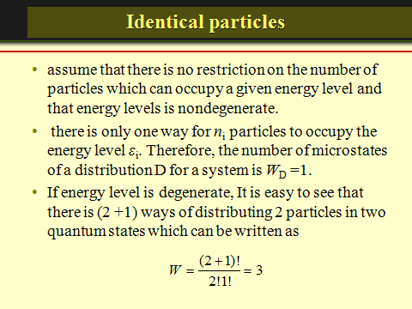
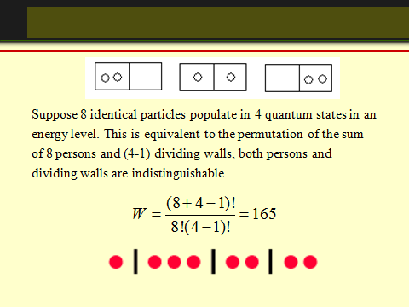
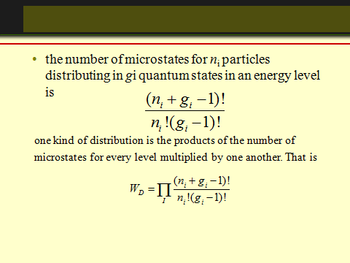
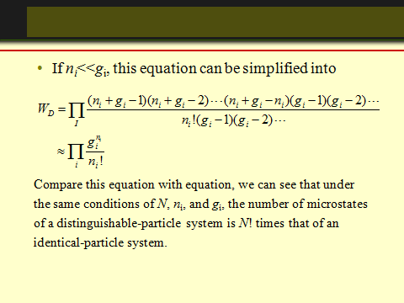
Statistical thermodynamics

Slide 32
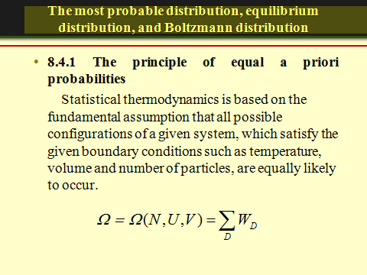
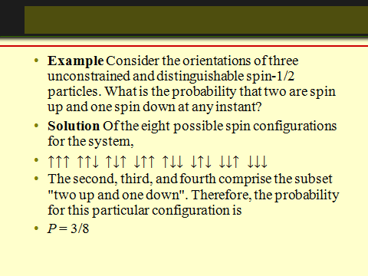
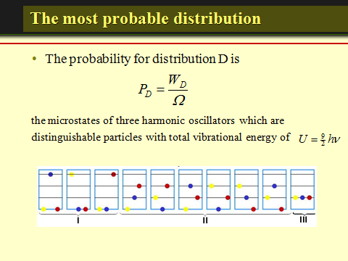
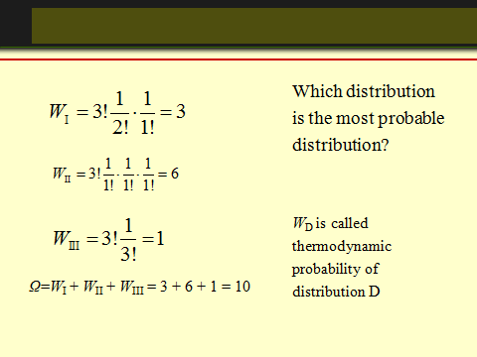
Statistical thermodynamics

Slide 33




Statistical thermodynamics

Slide 34



Statistical thermodynamics

Slide 35



Statistical thermodynamics

Slide 36




Slide 37



Slide 38





Slide 39





Slide 40




Statistical thermodynamics

Slide 41




Statistical thermodynamics

Slide 42




Statistical thermodynamics

Slide 43




Statistical thermodynamics

Slide 44

The Maxwell-Boltzmann Distribution
The Maxwell-Boltzmann distribution is the classical distribution function for distribution of an amount of energy between identical but distinguishable particles.
Besides the presumption of distinguishability, classical statistical physics postulates further that:
There is no restriction on the number of particles which can occupy a given state.
At thermal equilibrium, the distribution of particles among the available energy states will take the most probable distribution consistent with the total available energy and total number of particles.
Every specific state of the system has equal probability.
One of the general ideas contained in these postulates is that it is unlikely that any one particle will get an energy far above the average (i.e., far more than its share). Energies lower than the average are favored because there are more ways to get them. If one particle gets an energy of 10 times the average, for example, then it reduces the number of possibilities for the distribution of the remainder of the energy. Therefore it is unlikely because the probability of occupying a given state is proportional to the number of ways it can be obtained.

Slide 45

The Maxwell-Boltzmann Distribution

Slide 46
Distinguishability of Particles
The Einstein-Bose and Fermi-Dirac distributions differ from the classical Maxwell-Boltzmann distribution because the particles they describe are indistinguishable. Particles are considered to be indistinguishable if their wave packets overlap significantly. This kind of consideration comes from the fact that all particles have characteristic wave properties according to the DeBroglie hypothesis . Two particles can be considered to be distinguishable if their separation is large compared to their DeBroglie wavelength. For example, the condition of distinguishability is met by molecules in an ideal gas under ordinary conditions. For oxygen gas at STP, the molecules have a separation on the order of 3 nm and DeBroglie wavelengths on the order of 0.03 nm, a factor of a thousand smaller. On the other hand, two electrons in the first shell of an atom are inherently indistinguishable because of the large overlap of their wavefunctions.

Slide 47
Bose-Einstein Condensation
In 1924 Einstein pointed out that bosons could "condense" in unlimited numbers into a single ground state since they are governed by Bose-Einstein statistics and not constrained by the Pauli exclusion principle. Little notice was taken of this curious possibility until the anomalous behavior of liquid helium at low temperatures was studied carefully.
When helium is cooled to a critical temperature of 2.17 K, a remarkable discontinuity in heat capacity occurs, the liquid density drops, and a fraction of the liquid becomes a zero viscosity "superfluid". Superfluidity arises from the fraction of helium atoms which has condensed to the lowest possible energy.
A condensation effect is also credited with producing superconductivity. In the BCS Theory, pairs of electrons are coupled by lattice interactions, and the pairs (calledCooper pairs) act like bosons and can condense into a state of zero electrical resistance.
The conditions for achieving a Bose-Einstein condensate are quite extreme. The participating particles must be considered to be identical, and this is a condition that is difficult to achieve for whole atoms. The condition of indistinguishability requires that the deBroglie wavelengths of the particles overlap significantly. This requires extremely low temperatures so that the deBroglie wavelengths will be long, but also requires a fairly high particle density to narrow the gap between the particles.

Slide 48



 | How many ways can you distribute 9 units of energy among 6 identical particles? The three distributions of particles at left each have the same energy, the same kind of particles, and the same number of particles, yet the distribution at the right is 30 times more likely than the one at the left. Why is this? For thedistinguishable particles which are presumed by the Maxwell-Boltzmann distribution, it matters not only how many particles are in each state, but which particles are in each state.
Blatt uses the term "macrostate" to describe the characterization of the system which gives just the number of particles in each state; the diagram above shows three of the 26 possible macrostates for this system. The term "microstate" is used for the more detailed characterization in which the specific energy level for each particle is given. The macrostate at left has only 6 microstates, because there are only 6 ways to put one particle in level 9 and the other 5 in level 0. But there are 180 ways to achieve the macrostate at right, so if every distribution is presumed to be equally likely, then the system is 30 times more likely to be found in the right hand macrostate.
The number of distinguishable ways to produce each distribution is given by
So for the three macrostates pictured above, the numbers of microstates are

Slide 49





Slide 50



